Slide 1
Analyzing Employment Sectors Using Adult Census Income Data
By Altab Tamboli

Slide 2
ABOUT THE PROJECT
The primary objective of this project is to analyze the employment distribution among individuals using the Adult Census Income dataset.
Specifically, the project aims to uncover patterns and trends related to demographics, work class, and income levels.
It has about 3256 rows and 15 column in data.

Slide 3
Question
Q1. Which age group has a high income ?
Q2. What is the relationship between education level and income?
Q3. What is the average number of hours worked per week across different occupations?
Q4. How many individuals work in each work class, and which one has the highest number?
Q5. What is the highest 5 individual Native Countries ?
Q6. Which Work Class Has High Capital Gains and Low Capital Gains?
Q7. Which Gender Has Higher Income ?
Q8. What is the average final weight for each race ?
Q9. What is the average age for each Marital Stauts category ?
Q10.Who are the top 10 individuals ranked by their education numbers?
Q11. Which genders gained and lost how much capital?
Q12. What is the average hours worked per week by gender ?
Q13. How many individuals work in each occupation ?
Q14. How many individuals work in each work class by hours worked per week?
Q15. What is the average hours worked per week by race?

Slide 4
Age groups with the highest income

Slide 5
Income by Education Level

Slide 6
Average Weekly Work Hours by Occupation

Slide 7
Individuals by Work Class

Slide 8
Top 5 Native Countries

Slide 9
Work Classes with High vs. Low Capital Gains

Slide 10
Income by Gender

Slide 11
Average Final Weight by Race

Slide 12
Average Age by Marital Status

Slide 13
Top 10 Individuals by Education Level

Slide 14
Capital Gains and Losses by Gender

Slide 15
Average Weekly Hours by Gender

Slide 16
Occupational Distribution of Workers

Slide 17
Work Class Distribution by Weekly Hours Worked

Slide 18
Average Weekly Hours Worked by Race

Slide 19
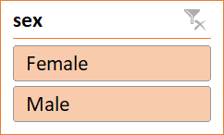
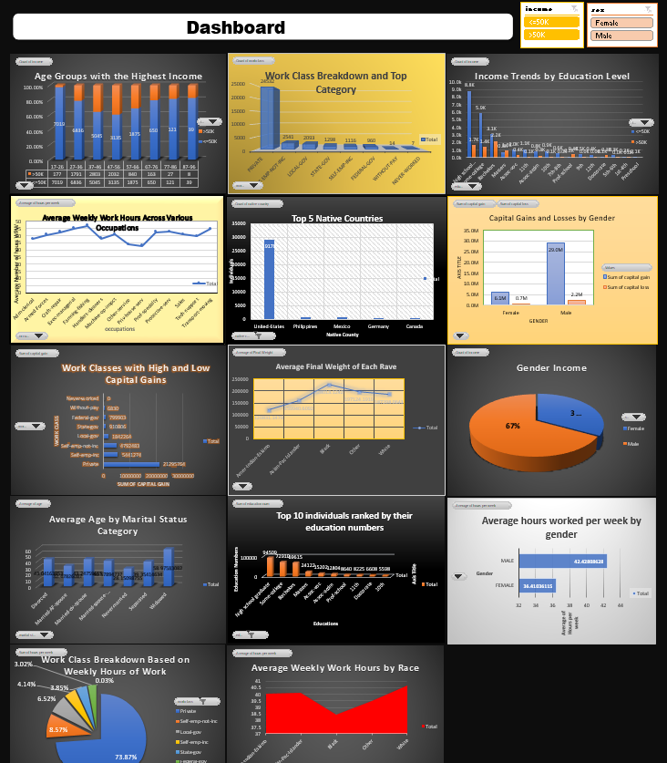

Dashboard
Dashboard
Dashboard

Slide 20
Conclusion :-
In this project, the Adult Census Income dataset was analyzed to determine the number of individuals working in the private sector. Using Excel's PivotTable feature, the analysis was efficient and straightforward.
The PivotTable revealed that there are 22,696 individuals employed in the private sector. This demonstrates the effectiveness of PivotTables in quickly summarizing and analyzing categorical data, providing valuable insights into employment distribution within the dataset.

Slide 21
Thank you

